Slide 1


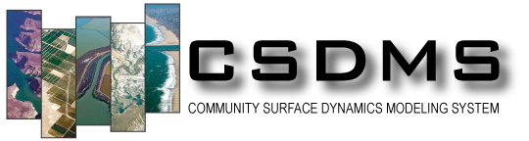


Landlab Modeling Framework
Sai S. Nudurupati¹, Amanda Manaster¹, Christina Bandaragoda¹, Erkan Istanbulluoglu¹, Daniel E. J. Hobley⁴, Gregory E. Tucker², Nicole M. Gaspirini³, Nathan Lyons³, Jordan M. Adams², Katherine R. Barnhart², Eric W. H. Hutton², and Margaux Mouchene²
1 - University of Washington
2 - University of Colorado
3 - Tulane University
4 – Cardiff University

Slide 2
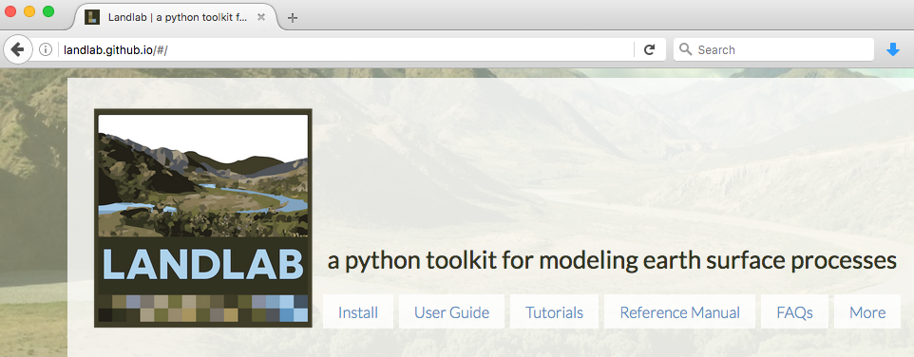
What is Landlab?
Earth surface dynamics modeling framework
developing and coupling of 2D numerical models that simulate earth surface processes
open-source programming library written in Python language
landlab.github.io

Slide 3
Landlab provides:
robust, reusable components that describe earth surface processes
a 2D gridding engine for structured and unstructured grids
data structures for storing and managing data
tools for:
data I/O
visualization of Landlab grids and data structures

Slide 4
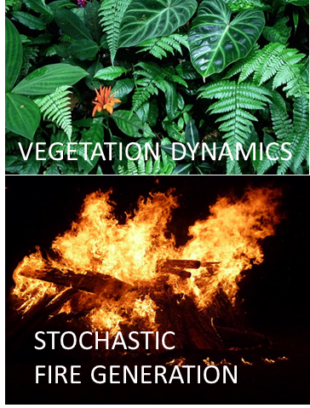
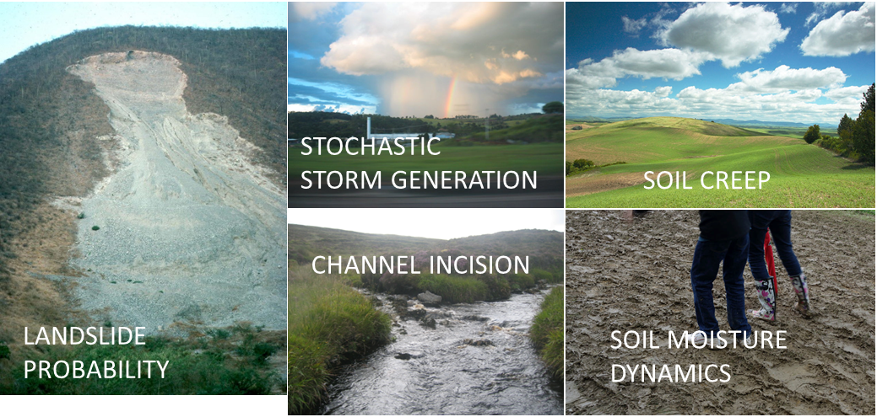
Landlab: components
A component models a single process (e.g., flow routing, linear diffusion, erosion)
Has a standard interface and can be coupled using a short Python script (driver)
Is initialized using input grid and parameters
Updates relevant data on the grid

Slide 5
Landlab: grid creation and data management
Create a structured or unstructured grid in one or a few lines of code
Attach data to the grid as ‘fields’
fields are scalars or 1D numpy arrays
passing the grid = passing data
grid = RadialModelGrid((3, 5))
grid = RasterModelGrid(shape=(10, 16))
NODE
LINK
CELL
grid = HexModelGrid(11, 10)
Notes:
1) fields create data arrays of the proper length for the associated grid element, and 2) fields attach these data to the grid, so that any piece of code that has access to the grid also has access to the data stored in fields.

Slide 6
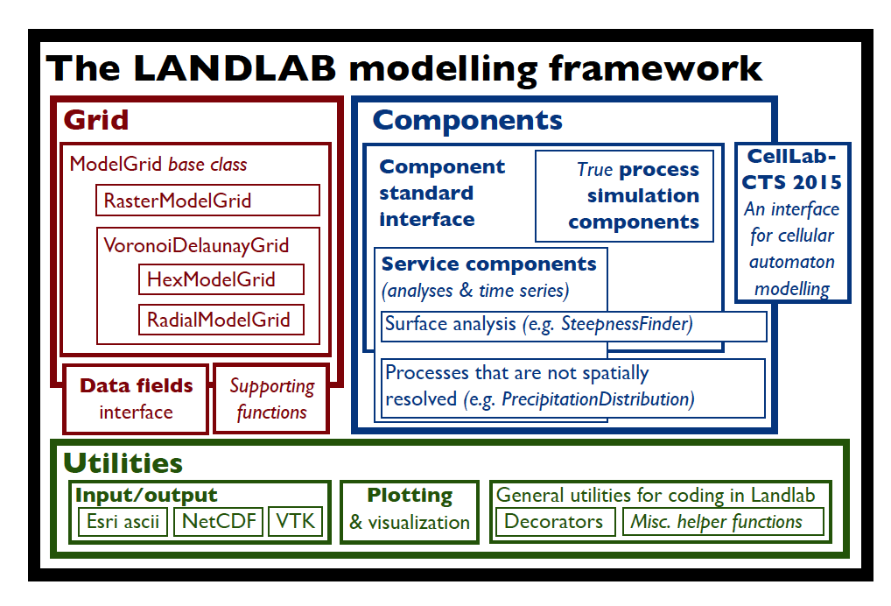

Slide 7
Landlab: creating a model
Output
Parameters
Data
DRIVER
(Python script)
COMPONENT 1
COMPONENT 2
…
COMPONENT N
GRID
…
FIELD 1
FIELD 2
FIELD N

Slide 8
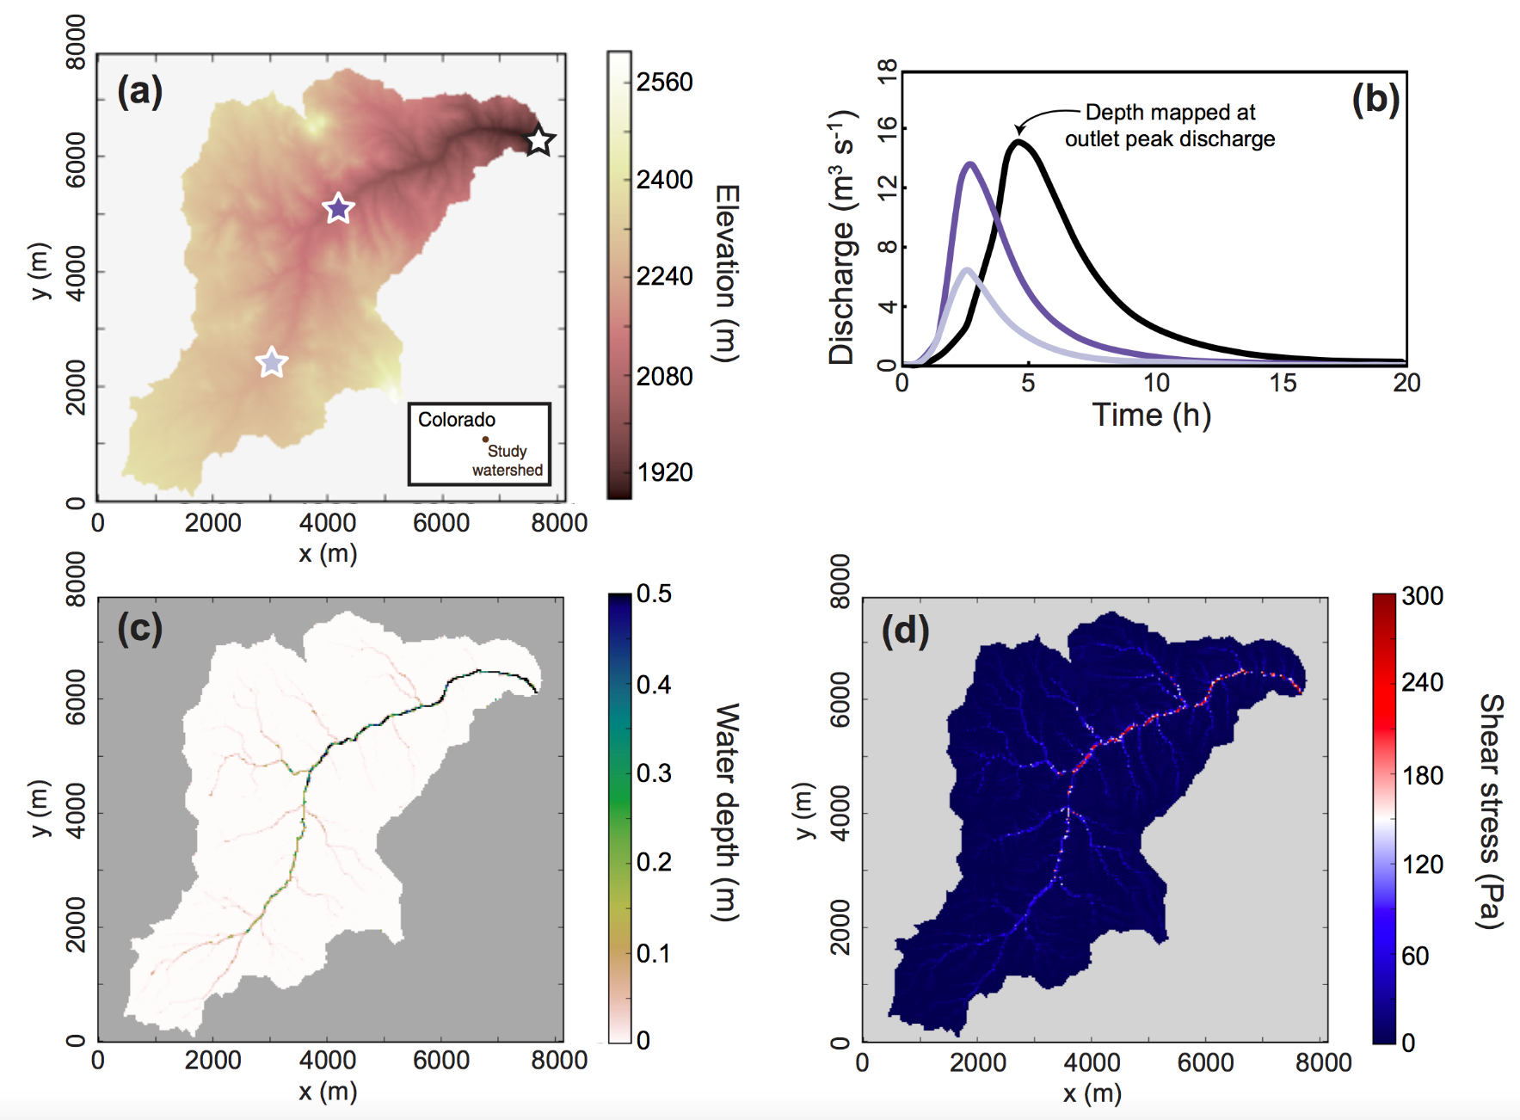
Landlab applications: basin rainfall-runoff model
(Adams et al., 2017 Geoscientific Model Development)

Slide 9
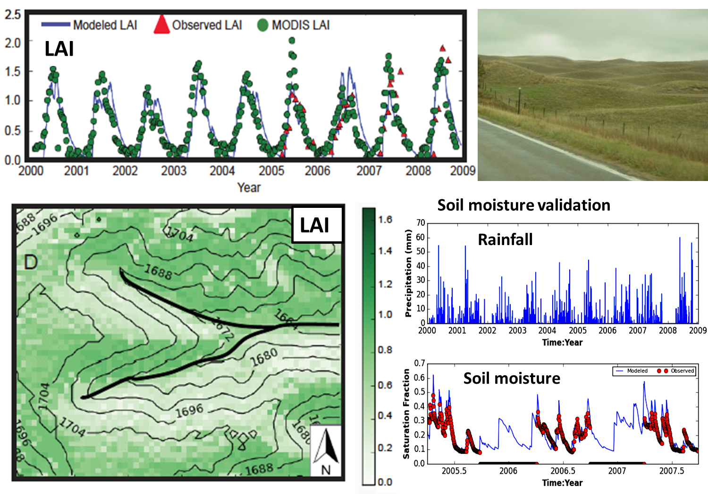
Landlab applications: vegetation dynamics model
Sandhills, Nebraska
Sai S. Nudurupati and Erkan Istanbulluoglu

Slide 10
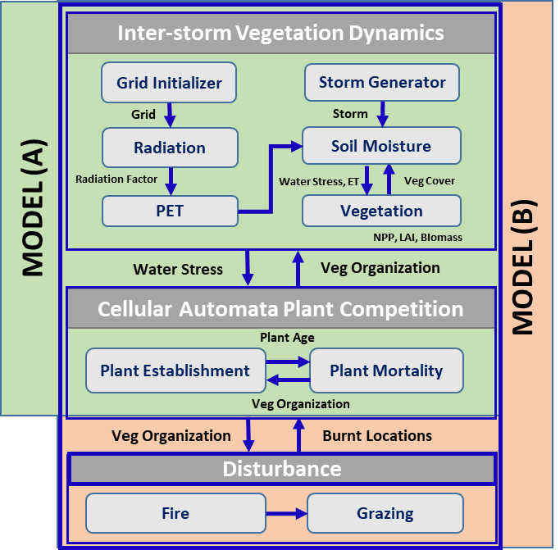
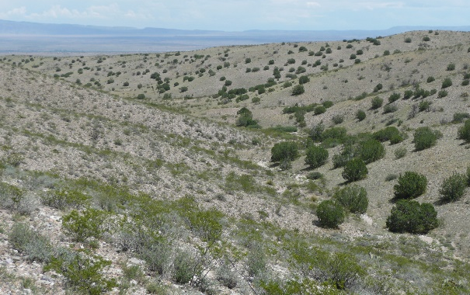
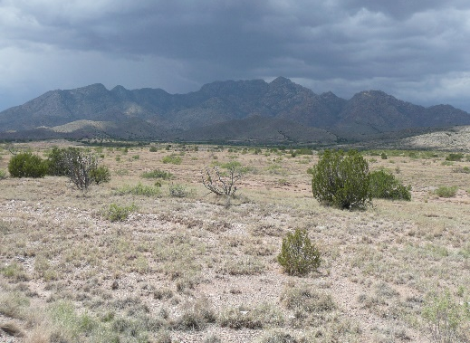


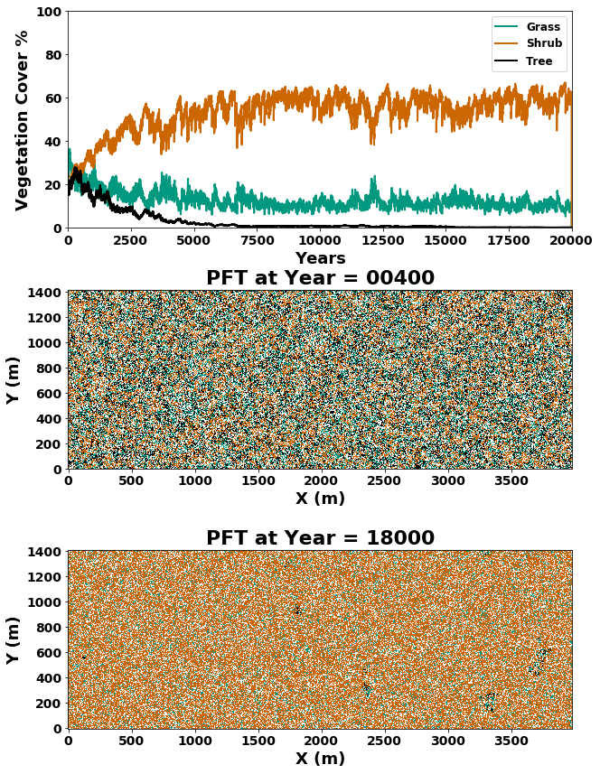
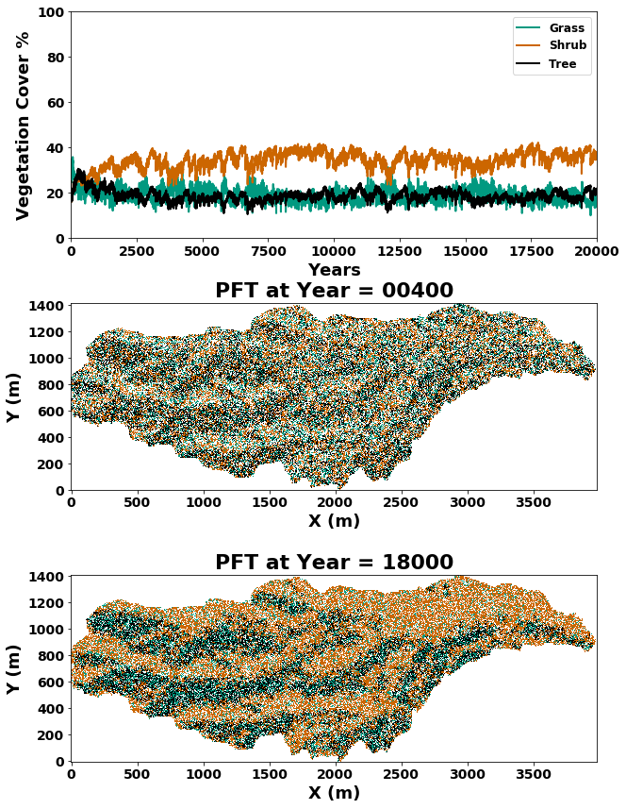
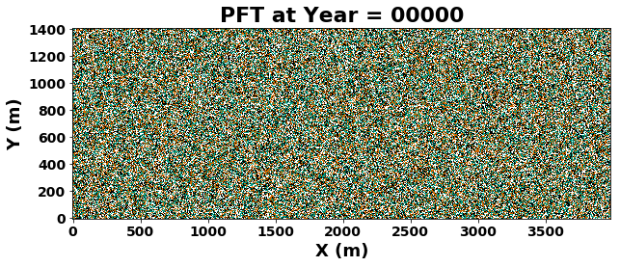
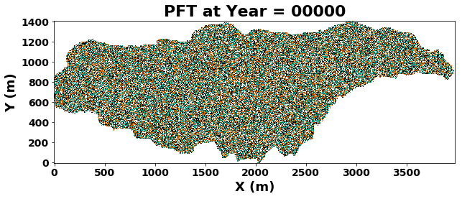
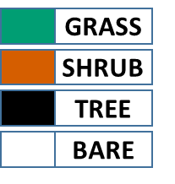

Landlab applications: vegetation-pattern evolution model
Flat Surface, Sevilleta, NM
Flat Domain
Topography
Studying the influence of topography on vegetation pattern evolution in semi-arid landscapes of southwestern USA – Sai S. Nudurupati & Erkan Istanbulluoglu

Slide 11
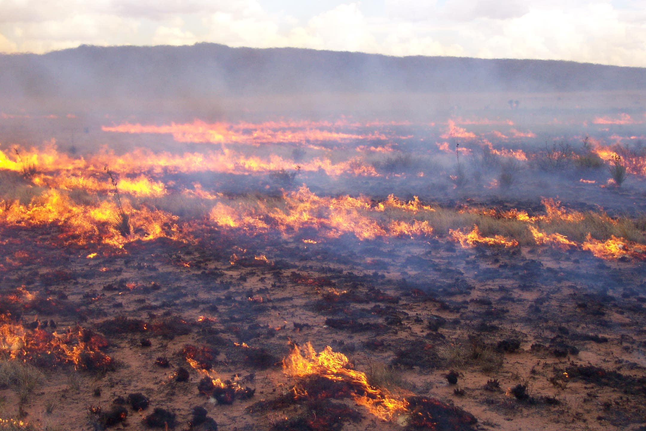
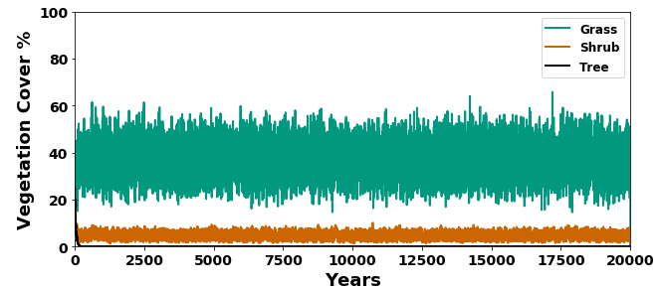
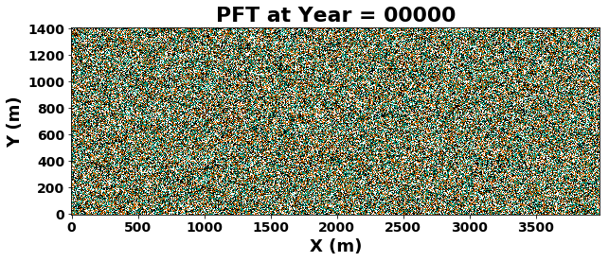
Landlab applications: vegetation-pattern evolution model
Flat Surface, Sevilleta, NM
Fires, Sevilleta LTER, NM
Flat Domain
Disturbance
Studying the influence of disturbance on vegetation pattern evolution in semi-arid landscapes of southwestern USA – Sai S. Nudurupati & Erkan Istanbulluoglu

Slide 12
References
Tucker, G. E., Hobley, D. E., Hutton, E., Gasparini, N. M., Istanbulluoglu, E., Adams, J. M., & Nudurupati, S. S. (2016). CellLab-CTS 2015: continuous-time stochastic cellular automaton modeling using Landlab. Geoscientific Model Development, 9(2), 823.
Hobley, D. E., Adams, J. M., Nudurupati, S. S., Hutton, E. W., Gasparini, N. M., Istanbulluoglu, E., & Tucker, G. E. (2017). Creative computing with Landlab: an open-source toolkit for building, coupling, and exploring two-dimensional numerical models of Earth-surface dynamics. Earth Surface Dynamics, 5(1), 21.
Adams, J. M., Gasparini, N. M., Hobley, D. E., Tucker, G. E., Hutton, E., Nudurupati, S. S., & Istanbulluoglu, E. (2017). The Landlab v1. 0 OverlandFlow component: a Python tool for computing shallow-water flow across watersheds. Geoscientific Model Development, 10(4).
Strauch, R. (2018). A hydroclimatological approach to predicting regional landslide probability using Landlab. Earth Surface Dynamics, 6(1).
Shobe, C. M., Tucker, G. E., & Barnhart, K. R. (2017). The SPACE 1.0 model: a Landlab component for 2-D calculation of sediment transport, bedrock erosion, and landscape evolution. Geoscientific Model Development, 10(12), 4577-4604.

